Slide 1

BACHELOR OF TECHNOLOGY
IN
Artificial Intelligence and Machine Learning
Project Title : IMAGE CAPTION GENERATOR
Batch Number:ST-01
Roll Numbers:2211CS020357
2211CS020358
2211CS020359
2211CS020360
2211CS020361
Project Guide : Prof. T.Ranga
Department of AIML, School of Engineering
Malla Reddy University

Slide 2
INTRODUCTION
Problem Identification
With the increasing use of digital media, automated image captioning has become essential for image indexing, accessibility for visually impaired users, and digital media management. This project leverages deep learning techniques to bridge the gap between visual perception and natural language understanding. This project is to develop an image caption generator capable of automatically producing descriptive captions for a wide range of images, including photographs, illustrations, and complex scenes. The system must analyze the visual content, identifying key elements such as objects, scenes, actions, and their relationships, and then generate a coherent, grammatically correct sentence that accurately describes the image. The captions should be natural-sounding, concise (typically one or two sentences), and provide a clear understanding of the image’s content .

Slide 3
Objective of Project
The main goal of this project is to create a computer program that can look at any picture and write a short sentence or two about what it sees. We call this program an image caption generator. The idea is to make a program that’s smart enough to understand pictures and describe them in a way that makes sense to people.
Scope of the Project
The scope of the Image Caption Generator is broad and impactful, as it combines computer vision and natural language processing to generate meaningful captions for images. This technology can be used in various fields, such as:
Accessibility for the Visually Impaired – Helps visually impaired users understand images through text descriptions.
Social Media & Content Creation – Automates caption generation for images, making content creation easier.
Image Tagging & Organization – Assists in categorizing and tagging images in large datasets.
E-commerce & Product Descriptions – Generates descriptions for product images, improving online shopping experiences.
Surveillance & Security – Helps in automatic image analysis for security monitoring.

Slide 4
ANALYSIS
Software requirement specification
Software requirement:
These are the essential tools and libraries needed for implementing the project. Programming Language: Python Development Environment: VS code Libraries and Frameworks:
NumPy & Pandas – For data manipulation and preprocessing.
NLTK / SpaCy – For text processing
Matplotlib & Seaborn – For visualization.
Flask – For deploying the model as a web app.
Hardware requirement:
These are the minimum hardware specifications required to run the project efficiently.
✔ Processor: Intel Core i5 ✔ RAM: Minimum 8GB RAM (16GB recommended for large datasets) ✔ Internet Connection: Required for downloading datasets and dependencies

Slide 5
MODEL SELECTION AND ARCHITECTURE
Model Selection
The ViT-GPT2 model was chosen because it can both understand images and generate meaningful captions. It consists of two key parts:
Vision Transformer (ViT): This part looks at the image and understands its contents. Instead of using traditional methods like CNNs (which scan images in a structured way), ViT splits the image into smaller patches and processes them like words in a sentence. This helps it get a better overall understanding of the image.
GPT-2: Once ViT understands the image, it sends the information to GPT-2, which is a language model trained to create human-like text. GPT-2 then forms a caption based on what it learned

Slide 6
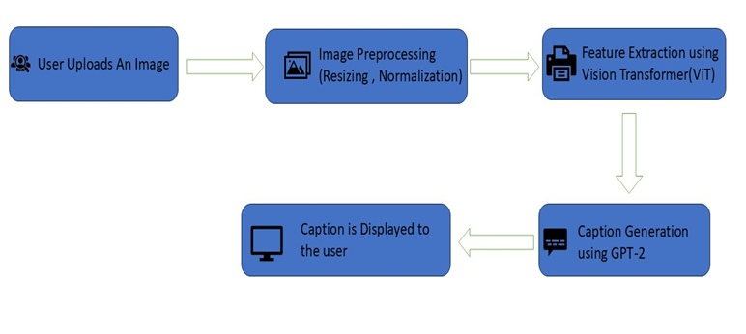
Architecture

Slide 7
User Uploads an Image
The user provides an image either by uploading it from their device or providing a URL.
Image Preprocessing
Pixel values are normalized to improve model performance and ensure consistency in input processing.
Feature Extraction using Vision Transformer (ViT)
The processed image is passed through the ViT (Vision Transformer) model, which extracts meaningful features from the image.
Caption Generation using GPT-2
The extracted features are passed to GPT-2, a powerful natural language processing (NLP) model.GPT-2 processes the visual information and generates a descriptive text caption that best represents the image.
Caption is Displayed to the User

Slide 8
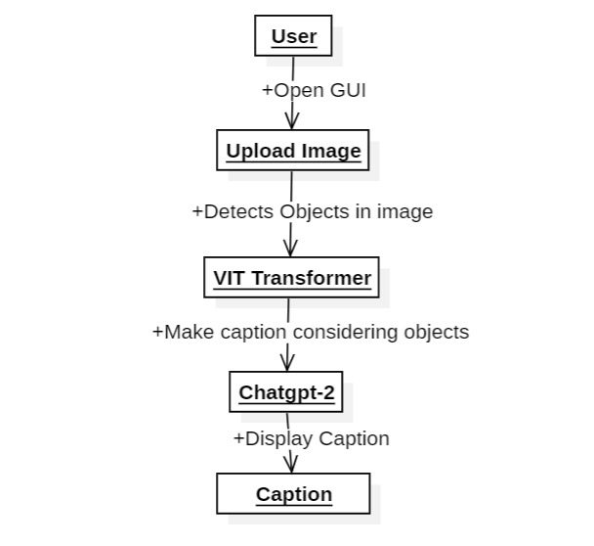
DESIGN
The design phase of the Image Caption Generator project focuses on structuring the system for efficient image processing and caption generation. This phase is crucial because it ensures that all components work together seamlessly, leading to accurate and meaningful caption generation.
Data Flow Diagram

Slide 9
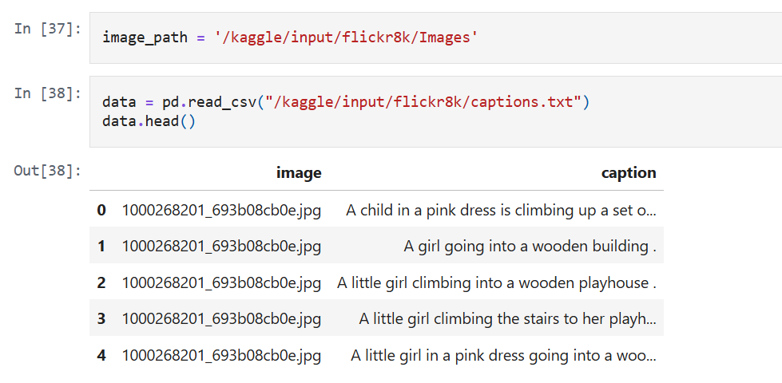
Data Set Descriptions
The Flickr8k dataset is used for training and testing the ViT-GPT2 image captioning model. It is a widely used dataset in computer vision and NLP for generating image descriptions.
Key Features of Flickr8k Dataset
Number of Images: 8,000 real-world images collected from Flickr.
Captions: Each image has five manually written captions describing the scene.

Slide 10
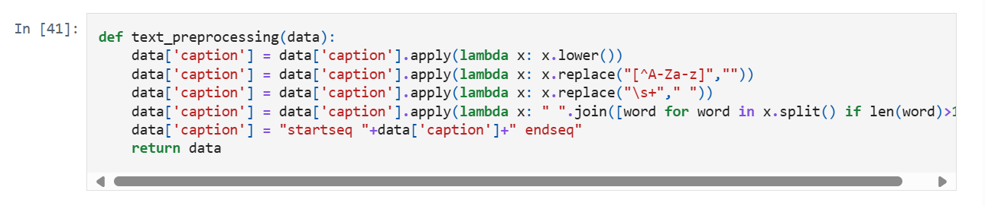
Data Preprocessing Techniques
Data preprocessing is necessary to make the raw data (images and captions) clean, structured, and understandable for the model. Without proper preprocessing, the model may struggle to learn, leading to poor accuracy and incorrect captions.

Slide 11
Methods and Algorithms
The key methods and algorithms used in the project are:
1. Vision Transformer (ViT) for Feature Extraction-ViT is efficient and accurate in understanding images without using traditional convolutional layers.
2.Image Splitting – The input image is divided into small patches instead of scanning the entire image at once.
3.Linear Projection – Each patch is converted into numerical data so the model can understand it.
4.Transformer Encoder – The processed patches are passed through a Transformer model, which learns the important patterns and relationships in the image.
5.Classification Layer– The final output is a label (e.g., "Car,""Bird,""Ball")

Slide 12
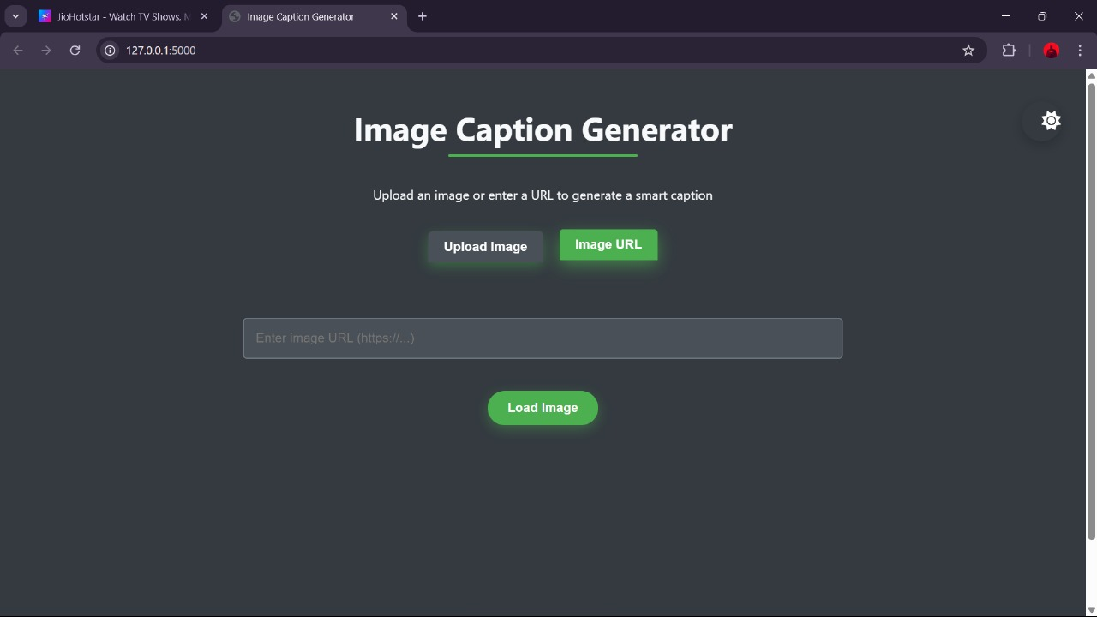
DEPLOYMENT AND RESULTS
Web GUI’s Development

Slide 13
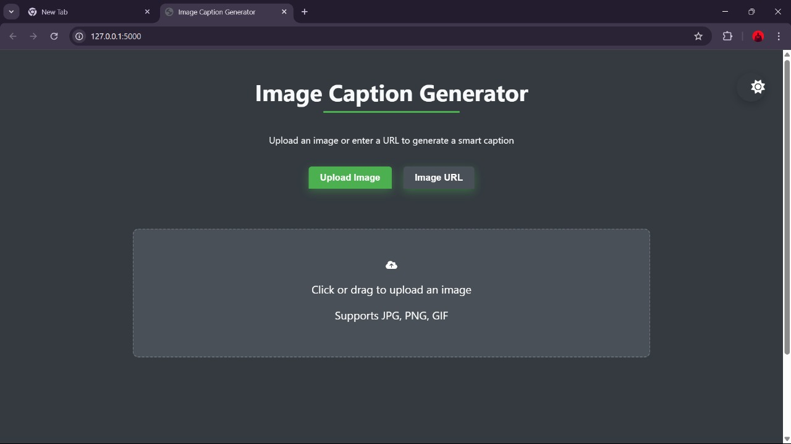

Slide 14
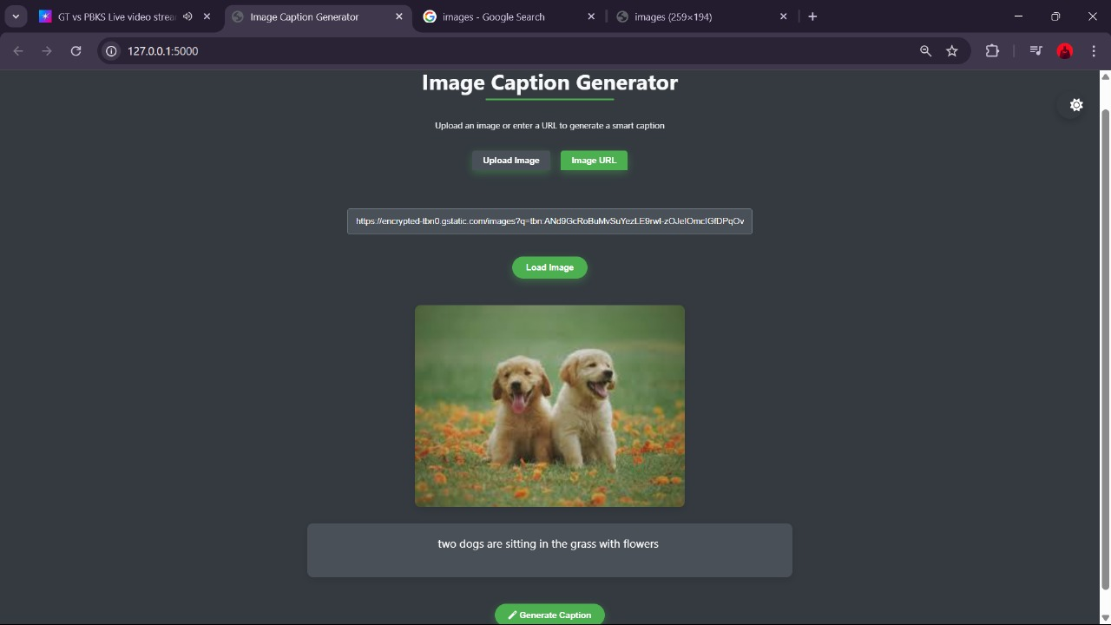
Results

Slide 15
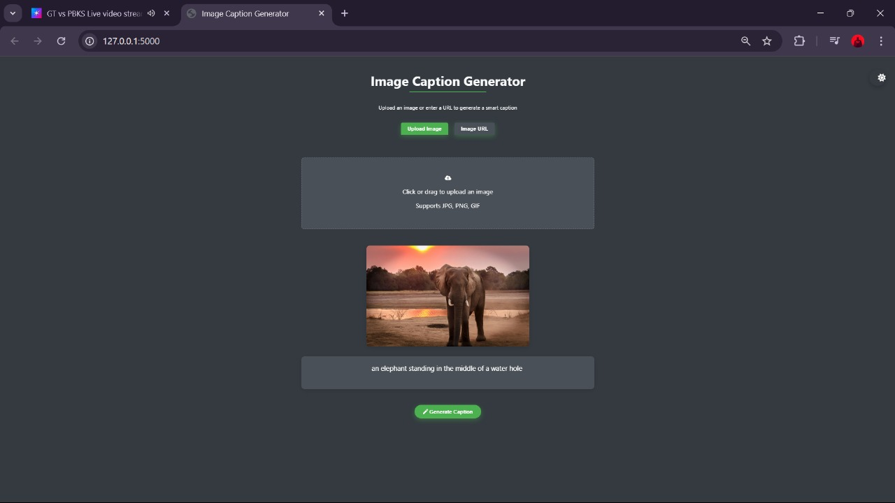

Slide 16
CONCLUSION
Project Conclusion
The Image Caption Generator project successfully demonstrates the integration of computer vision and natural language processing (NLP) to generate meaningful captions for images. By utilizing the ViT-GPT2 model, the system effectively extracts visual features and converts them into coherent textual descriptions.The project achieves real-time image captioning through a Flask-based API and a user-friendly web interface, making it accessible and easy to use. Overall, this system has practical applications in automated image tagging, accessibility support for visually impaired users, and digital content organization.

Slide 17
Future Scope
Multilingual Captioning – Extending support for multiple languages will make the system accessible to a global audience, enabling users to receive captions in their preferred language.
Real-Time Processing – Optimizing the model for faster inference can help generate captions instantly, improving usability in applications like video captioning and live content analysis.
Integration with Voice Assistants – Enhancing the system to work with voice assistants can enable audio-based image descriptions, benefiting visually impaired users.
Mobile and Cloud Deployment – Developing a mobile application or deploying the system on the cloud will provide users with greater accessibility and scalability, allowing them to generate captions on-the-go.

Slide 18
THANK YOU

